Slide 1
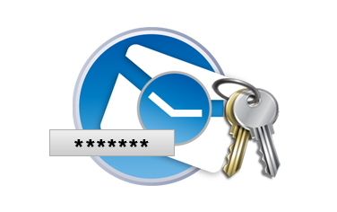
Modern Key-Derivation Functions
Scrypt
PBKDF2
Bcrypt
Argon2
Scrypt, Bcrypt, Argon2

Slide 2
Deriving Encryption Key from Password
Modern key-derivation functions (KDF)
Derive a key (of fixed length) from a password (text)
Resistant to dictionary attacks and ASIC-resistant
Bcrypt, Scrypt and Argon2 are secure KDF functions
Use salt + many iterations + a lot of CPU + RAM
It takes CPU time to derive the key (e.g. 0.2 sec) + memory (RAM)
Cracking passwords will be slow (e.g. 5-10 attempts / second)
Infeasible to perform a brute-force to guess the password

Slide 3
Key Derivation Functions: Scrypt
Scrypt (RFC 7914) is a strong cryptographic key-derivation function
Memory intensive, designed to prevent ASIC and FPGA attacks
key = Scrypt(password, salt, N, r, p, derived-key-len)
N – iterations count (affects memory and CPU usage), e.g. 16384
r – block size (affects memory and CPU usage), e.g. 8
p – parallelism factor (threads to run in parallel), usually 1
Memory used = 128 * N * r * p bytes, e.g. 128 * 16384 * 8 = 16 MB
Parameters for interactive login: N=16384, r=8, p=1 (RAM=16MB)
Parameters for file encryption: N=1048576, r=8, p=1 (RAM=1GB)

Slide 4
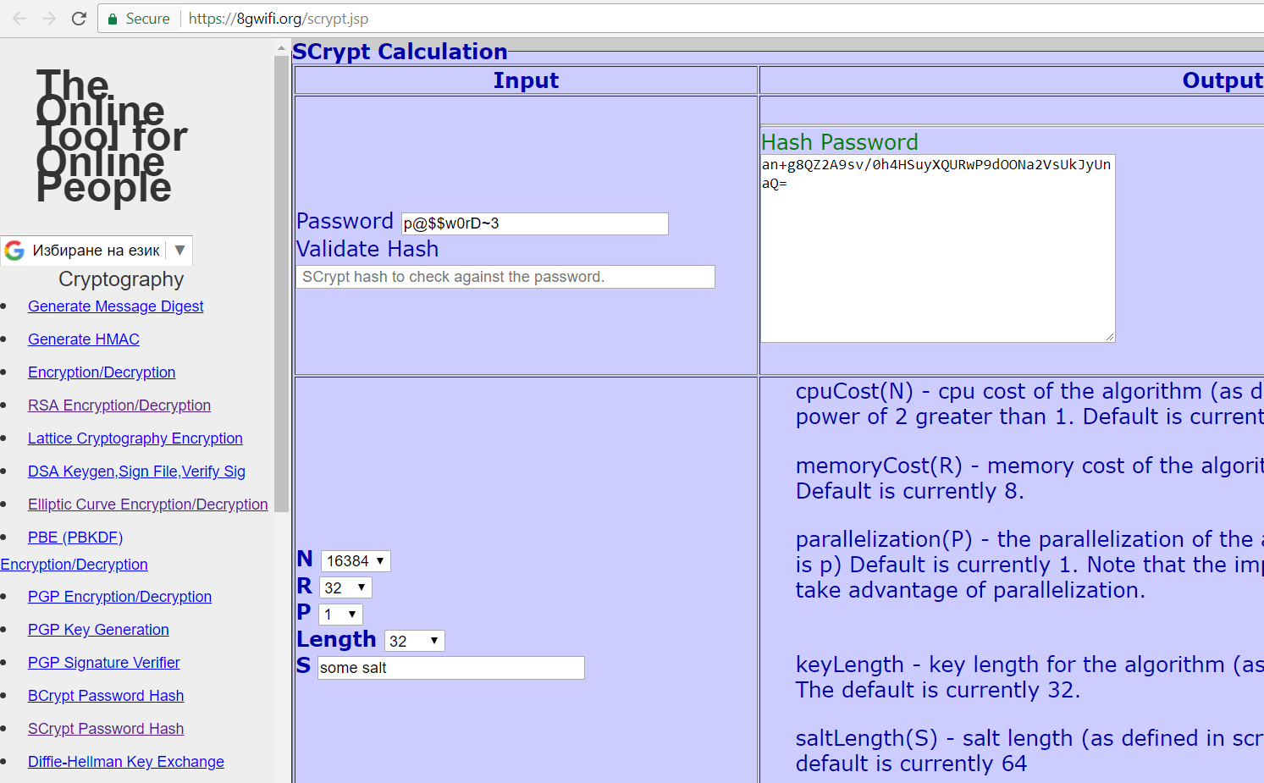
Scrypt Key Derivation
Live Demo
https://8gwifi.org/scrypt.jsp

Slide 5
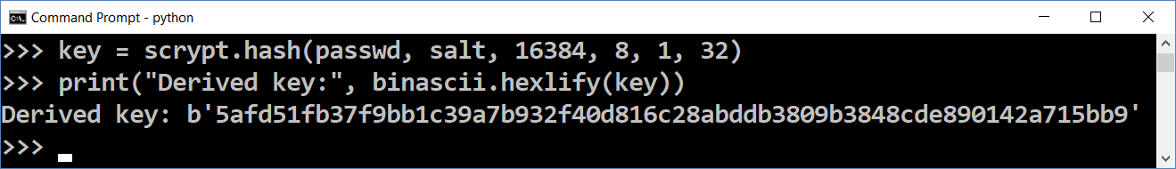
Scrypt Key Derivation in Python – Example
import scrypt, os, binascii
passwd = "p@$$w0rD~3"
salt = os.urandom(32)
print("Salt: ", binascii.hexlify(salt))
key = scrypt.hash(passwd, salt, 16384, 8, 1, 32)
print("Derived key:", binascii.hexlify(key))
pip install scrypt

Slide 6
Other Cryptographic KDFs: Bcrypt and Argon2
Bcrypt – https://en.wikipedia.org/wiki/Bcrypt
Older than Scrypt, less resistant to ASIC and GPU attacks
Configurable iterations count, but uses constant memory
Argon2 – https://en.wikipedia.org/wiki/Argon2
Modern ASIC-resistant and GPU-resistant key-derivation function
Argon2d – strong GPU resistance, potential side-channel attacks
Argon2i – less GPU resistance, no side-channel attacks
Argon2id – recommended (combines the Argon2d and Argon2i)

Slide 7
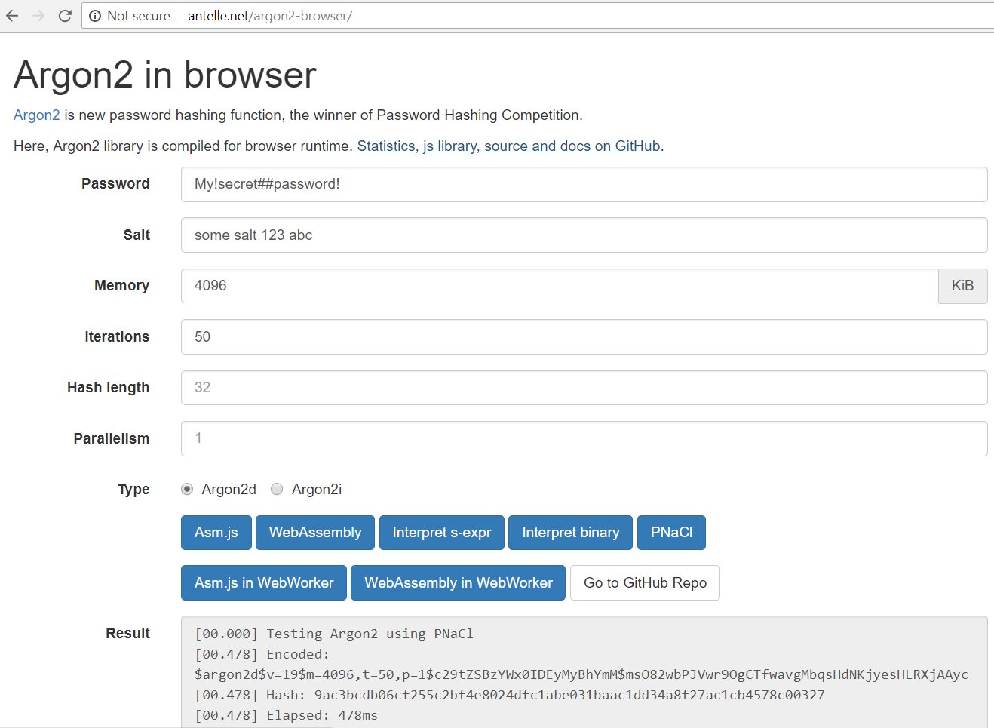
Argon2
Live Demo
http://antelle.net/argon2-browser/

Slide 8

Modern Key-Derivation Functions
Try the Demo!

